Slide 1
Recursion Types
Lecture #
By: Abdul Aleem.

Slide 2


Contents
1
Linear Recursion
2
Binary Recursion
3
Multiple Recursion
4
Practice Questions on Recursion

Slide 3
Types of Recursion
Recursion may be further categorized as:
Linear recursion
Binary recursion
Multiple recursion

Slide 4
Linear Recursion
The linear recursion defines all possible recursive calls. But, perform a single recursive call out of all the several possible recursive calls in the algorithm, which progress towards a base case.
The algorithms discussed above (fact (n), gcd (a, b) and print (n)) are examples of linear recursion.

Slide 5
Linear Recursion
In binary recursion, there are two recursive calls for each non-base case.
The generation of n^{th} Fibonacci term in the series is an example of binary recursion. Here, there are two recursive calls for each term that are fibo(n − 1) and fibo(n − 2).
Drawing the recursion tree helps in understanding binary recursion.

Slide 6
Binary Recursion
Example 1: To generate n^{th} term of Fibonacci series
The recursive algorithm for the generation of n^{th} Fibonacci series term is shown in Algorithm 4.
Algorithm 1 fibo(n) //Binary Recursion
Require: a positive integers n > 1.
Ensure: generate n^{th} Fibonacci series term.
1: if n == 0 then
2: return 0;
3: else if n == 1 then
4: return 1;
5: else
6: return fibo(n − 1) + fibo(n − 2);
7: end if

Slide 7
Binary Recursion
fibo(4)
1
2 + 1 = 3
6
fibo(3)
1 + 1 = 2
5
1 + 0 = 1
7
fibo(2)
2
8
fibo(2)
1 + 0 = 1
4
fibo(1)
fibo(1)
fibo(0)
3
1
1
0
fibo(1)
fibo(0)
1 0
Figure 1: Binary Recursion - To generate n^{th} term of Fibonacci series (label on the edge indicates the sequence of the recursive call)

Slide 8
Binary Recursion
Example 2: Tower of Hanoi
Tower of Hanoi, is a mathematical puzzle which consists of three towers (pegs) and more than one rings. These rings are of different sizes and stacked upon in an ascending order, i.e. the smaller one sits over the larger one. The objective of the puzzle is to move the entire stack of rings from one tower to another, obeying three simple rules as follows:
Only one disk can be moved among the towers at any given time.
Only the ”top” disk can be removed.
No large disk can sit over a small disk.

Slide 9
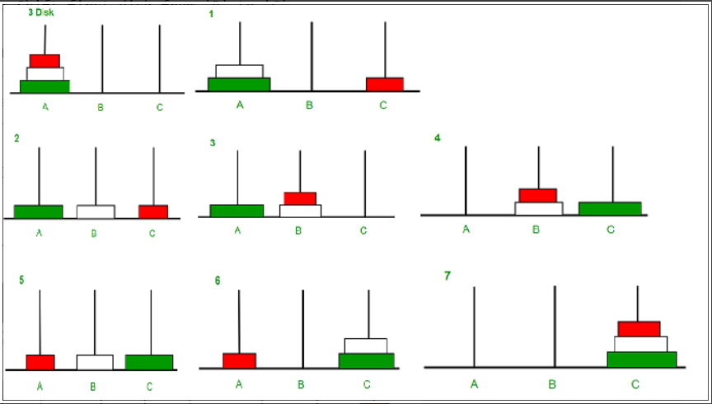
Binary Recursion
For number of rings n = 3 the steps required to move them from tower A to tower C using temporary tower B are 1) A to C , 2) A to B , 3) C to B , 4) A to C , 5) B to A , 6) B to C , 7) A to C. This is shown in Figure 2.
Figure 2: Solution of Tower of Hanoi problem for n = 3

Slide 10
Binary Recursion
The tower of hanoi algorithm is presented in Algorithm 5 and its recursion tree is presented in Figure 3.
Algorithm 2 Tower (n, A, C, B) //Tower of Hanoi
Require: a positive integers n ≥ 1 and three characters to represent towers, A (from tower), B (temporary tower), and C (to tower).
Ensure: rings moved from tower A to C.
1: if n ≥ 1 then
2: return Tower (n − 1, A, B, C);
3: move ring from A to C;
4: return Tower (n − 1, B, C, A);
5: end if

Slide 11
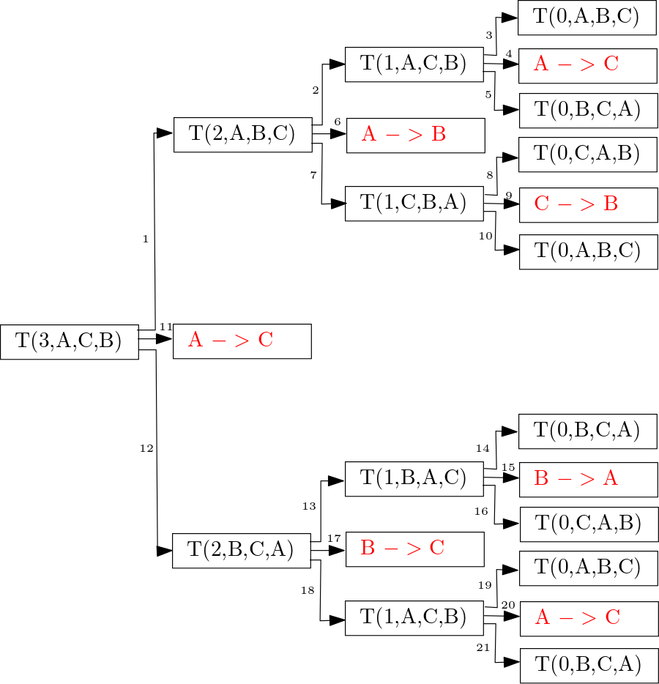
Binary Recursion
Figure 3: Recursion tree for Tower of Hanoi problem (n = 3)

Slide 12
Multiple Recursion
In multiple recursion, there are many recursive calls. One of the mo- tivating examples of multiple recursion is summation puzzles. Multiple recursion is out of the scope of this document.

Slide 13
Practice Questions on Recursion
1
Find x^{y} using a recursive method power (x, y ).
Write a recursive method to find sum of the digits of a number. Write a recursive Java method to reverse an array.
Write a recursive Java method to implement linear search. Write a recursive Java method to implement binary search.
Write a recursive to print the binary equivalent of a given number. Write a recursive method to get the largest element of an array.
Write a program in Java to check whether a given String is Palindrome or not.
2
3
4
5
6
7
8

Slide 14
References
Y Daniel Liang ‘Introduction to JAVA Programming, Comprehensive Version’,
Pearson, 2014.

